Slide 1
Concepts of Demand (or) Types of Demand
P. Swathi, MBA(Finance & HRM),LLB,Mcom,OU(Phd), Asst. Professor, RGUKT,IIIT Campus, Basar.

Slide 2
Short run and Long run Demand:
Short run demand may be taken to mean immediate, existing demand which is based on given tastes and preferences, available technology and given economic environment.
Long run demand on the other hand refers to size and pattern of demand, which is likely to prevail in future as a result of changes in technology, tastes, product improvement and promotional efforts and such other factors where adjustments take place over a period of time.
Price, income fluctuations are more relevant as determinants of short run demand, while changes in food habits, urbanization, work culture etc must be considered for long run demand analysis.

Slide 3
Individual and Market demand:
Individual demand indicates the purchase pattern of an individual or a consumer at different prices. The individual demand schedule gives us information related to purchase pattern of a consumer at different prices.
For example:

Slide 4
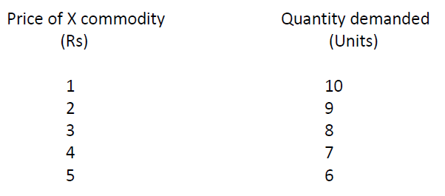

Slide 5
The above shown demand schedule indicates quantity demanded of a commodity by a particular consumer corresponding to different prices.
But the reality is that a market is visited by large number of consumers with varying degree of income, tastes, age, etc.
As a result the business firm must have an idea about the market demand for the commodity in order to arrive at optimal decisions regarding the level of out put to be produced.
Because these different consumers react differently to the prevailing market price of a commodity.

Slide 6
By constructing individual demand schedules and through horizontal summation of individual demand of different consumers at any given price, we can arrive at market demand for the product.
The market demand schedule represents aggregate purchase behavior of consumers in the market.
We can understand derivation of market demand schedule as shown below.

Slide 7
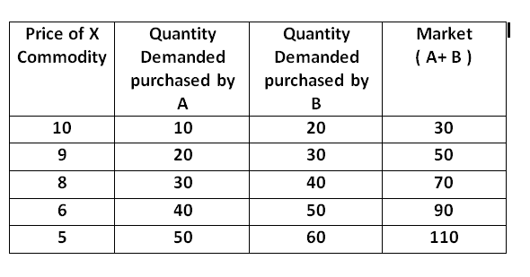

Slide 8
This example is given by assuming there are two consumers for X commodity.
In fact there are millions of consumers for any product. To simplify the analysis we have taken into account two consumers. In the above table the market demand is arrive at by adding together individual demand at any given price.
For example at price Rs 8, the quantity purchased by consumer A is 30 units while B is 40 units. Therefore the market demand is 30 + 40 =70 units.
In this way we can find out market demand for the commodity at any given price. Like individual demand curve the market demand curve also slopes downward from left to right.

Slide 9
Segmented market and Total Market Demand
Segmented market demand indicates the demand for a product in one segment i.e one part of the market. A business firm may place its commodity in different geographic locations across the world. For example:
Domestic market and foreign market. Hindustan Machine Tools sell its commodity i.e watches, in domestic as well as foreign market. The demand for its product in domestic market and foreign market separately constitute segmented market demand.

Slide 10
On the other hand the demand fro its product in domestic and foreign market together represents total market demand.
Through horizontal summation of segmented market demand at any given price, we can arrive at total market demand. Total market consisting of varying degrees of income, tastes and preferences, traditions, external environment etc represent aggregate picture of demand for the product of a firm . This we can understand with the following example.

Slide 11
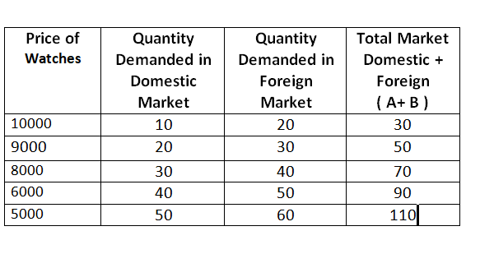

Slide 12
Company and Industry Demand:
An industry is the aggregate of firms/companies. We generally come across the words: software industry, iron and steel industry, cement industry etc.
For example: in software industry Micro Soft, Wipro, Satyam, TCS, and many other companies are there. The demand for software products of a particular firm represents company demand. The demand for software products of all firms together represents industry demand.

Slide 13
Each and every company must have an idea about the movement of industry demand to know trend o demand for its product.
Through horizontal summation of company demand, we can derive the industry demand. The derivation process of industry demand is same as that of the derivation process of total demand and market demand.

Slide 14
Direct and Derived:
Direct demand refers to demand for goods meant for final consumption. It is the demand for consumer goods such as food items, readymade garments, cigarettes etc.
On the other hand, derived demand refers to demand for goods which are needed for further production. It is the demand for raw materials and factors of production like labor.
Thus demand for inputs or factors of production, is a derived demand. The demand for raw material depends on the demand for output where raw materials are used to produce that output.

Slide 15
Induced and Autonomous:
When the demand for a product is influenced by the demand for some other product, it is called as induced demand. For example: the demand cement, iron and steel is generally influenced by demand housing or construction. So the demand for these commodities is induced in nature.
The demand for all complementary goods such as tea-sugar, bread-butter, automobiles and petrol etc is induced demand.

Slide 16
Autonomous demand is not derived or induced. It is independent demand. Though theoretically we can speak of autonomous demand but in reality the demand for all commodities is derived/ induced.
In the context of demand analysis, for the estimation of demand, economists use the demand function Qd = a – bPx.
Here ‘a’ is the autonomous component and ‘b’ is the induced component of demand.

Slide 17
Perishable goods and Durable goods Demand:
The demand for bread, raw material like cement which can be used only once, is called perishable demand.
The same unit of these goods cannot be used repeatedly. On the other hand the demand for capital goods such as machinery, car, consumer goods such as shirt, television, is called durable goods demand. The owner of these commodities can put these commodities in use repeatedly.

Slide 18
Domestic and Industrial Demand:
The internal demand for firms’ product is called domestic demand. The external demand for firm’s product is called industrial demand. Assume that Tata Company produced 10 million tonnes of steel in the year 2010.
Out of the total 10 million tones, its internal demand was 2million tonnes. This is called domestic demand. The demand from other industries in the economy was 8 million tones. This is called industrial demand.

Slide 19
New and Replacement Demand;
If the purchase of an item is meant as an addition to stock, it is new demand. For example: the demand for latest model a television. Constitute new demand. On the other hand the demand spare parts represent replacement demand.

Slide 20
Final and intermediate demand:
Demand for final product such paint represents final demand.
Where as the demand for intermediate products such as chemicals, which are used as input in the production of paint to improve the quality of paint, is called as intermediate demand.

Slide 21
Change in quantity demanded and change in demand:
Change in quantity demanded is always with reference to a movement along the same demand curve. The change in purchases of a consumer due to change in price, ceteris paribus, is called as change in quantity demanded.
This is denoted in terms of either extension in demand or contraction in demand. On the other hand, change in demand is always with reference to a shift in demand curve.
The change in purchases of a consumer due to change in other than price, for example income, given the price, is called as change in demand. This is denoted in terms of either increase in demand or decrease in demand.

Slide 22
Summary
In this module an attempt is made to familiarize to you the various concepts of demand.
The market demand concept helps the management to identify the nature of total market demand for their product.
Further the management can find out the nature of the product i.e. intermediate or final, they are producing. The understanding of these concepts helps the management to arrive at optimal decisions

